Slide 1
Sustainment in Deployment Optimization Tool (SiDOT)
Evan McCaleb
Jesse Mooney
Daniel Stovall

Slide 2
Course Project Assignment and Grading
Submittal Due Date Grade %
Project Plan September 01,2015 20
Presentation Charts December 04, 2015 30
Final Report December 04, 2015 50

Slide 3
Course Project Presentation
Presentation Outline (Suggested): 20 minutes
Overview (Summary of Presentation)
Pictures/Diagrams ( to increase understandability)
Statement of Need and Problem
Analysis/Study/Evaluation/Etc
Results
Summary and Conclusions (key points)
Grading Criteria
Understandability 10
Follow-through 10
Results 10
Total 30

Slide 4
Overview
ADD PICTURES/DIAGRAMS
Problem
Repair and modifications are often needed to effectively maintain deployable field assets in order to meet program reliability and availability requirements. However, multiple solutions can often be implemented to solve a given problem. A need exists to analyze which solution is optimal depending on materials availability and operational need.
Need
Develop tool to aid in determination of the optimum solution of a sustainment problem in the program deployment phase. The initial tool is tailored to the Lockheed Martin F-35 program, but it may be easily customized to other programs. The tool comparing multiple sustainment solutions for a given product and provide a direct comparison in cost, schedule, and performance impact of each.

Slide 5
Assumptions/Limitations

Slide 6
Flow Chart

Slide 7
Tool Study

Slide 8
Tool Design

Slide 9
Tool Analysis

Slide 10
Tool Evaluation

Slide 11
Results

Slide 12
Summary and Conclusions

Slide 13
Project Proposal
Scope
Develop tool to aid in determination of the optimum solution of a sustainment problem in the program deployment phase. This tool determines optimal repair solutions based on available resources to minimize downtime and costs. The initial tool is tailored to the Lockheed Martin F-35 program, but it may be easily customized to other programs.
Motivation
Repair and modifications are often needed to effectively maintain deployable field assets in order to meet program reliability and availability requirements. However, multiple solutions can often be implemented to solve a given problem. A need exists to analyze which solution is optimal depending on materials availability and operational need.
Goal
Deliver a tool capable of comparing multiple sustainment solutions for a given product and provide a direct comparison in cost, schedule, and performance impact of each.

Slide 14
Project Description
Objectives
Deliver user-friendly tool that takes a wide variety of minor product anomalies and outputs an approved solution that fits the optimal solution for cost, and availability.
Needs
Materials Database
Tooling and Support Equipment Database
Proposed Solution Costs
Program Reliability Requirements
Program Availability Requirements

Slide 15
Project Description
Tool Development Resource Requirements
Software Engineering for Developing Tools
Systems Engineering for Reliability/Availability Analysis
Logistical and Field Tech Support for Creating Databases and Assumptions
Software Package
Risks
Inaccurate Materials/Tooling Database
Buy-in from Joint Project Office (JPO), Program Management (PM), Support Teams, Chief Engineer Office
Inaccurate Dispositions

Slide 16
Project Description
Tool Benefits
Decreased product downtime due to the normal period of time it takes to obtain an approved repair disposition
Known logistical constraints such as materials, new components, consumables, required hazmat, etc.
Tool program that is easy to learn, maintainable, and usable by many consumers
Intended Achievements
Provide the best logistical, most engineered solution in an expedited time frame in order to increase product availability
Example Demonstration Case: Misdrilled hole in an F-35 exterior access panel due to a stuck fastener.

Slide 17
Project Description
Statement of Work for Program Release 0.1
1. Program
1.1. Inputs
1.1.1. Materials Availability and Cost Database Integration
1.1.2. Support Equipment Database Simulated with single “Maintenance space” variable
1.1.3. Cost and Availability Limits
1.1.4. User Assigned Cost and Availability Weights
1.1.5. Repair type Database with a Minimum of 3 Repairs which Address a Single Problem
1.1.6. Limited Fleet Data for Multi-Aircraft Simulation
1.2 Interfaces
1.2.1 – Ability to Load Limited Databases from CSV files
1.2.2 – Simple GUI

Slide 18
Project Description
Statement of Work for Program Release 0.1 Cont.
1.3 Output
1.3.1 Optimized List of Repair
1.3.1.1 Summarized Cost and availability impacts
1.3.2 Analysis Aids
1.3.3 Minimum of 3 Analysis aids that allow assessment of Cost vs Availability, Future Availability Impacts, Performance Impacts, etc.
2. Report
2.1 Must Follow Requirements Outlined In Course Assignment
2.2 Appendix Including Project Source Code
3. Presentation
3.1 Will Include Tool Usage Demonstration

Slide 19
Tool Summary
Inputs:
Deployed Product Availability Requirement
Single Aircraft Availability
Fleet Availability
Material and Tooling Availability Onsite
Repair Types
Material and Equipment Requirements
Deployment capable repairs vs. depot level
Cost associated with each type of repair
Downtime (availability)
Effectiveness of each type of repair
Cost vs. Availability Weights
Maximum Cost Requirements

Slide 20
Tool Summary
Outputs:
Repair Solutions listed by Optimality of Cost and Availability
Potential for combined solution in multi aircraft simulation (e.g .optimal solution 4 aircraft receive repair A and 6 aircraft repair B)
Analysis Tools
Reliability vs. Time function
Cost, Cost vs. Time
Schedule Impacts (Availability)
Performance Impact
Complexity (or Risks associated w/ repair) (Depot vs. Field)

Slide 21
Task List
Data Gathering (24 hours)
Identify Currently Available Databases Regarding Tool/Material Availability (8 hours)
Create Software Requirements, Interface Definitions (4 hours)
Create Database of Common Discrepancies (6 hours)
Create Database of Common Solutions (6 hours)
Reliability/Availability Analysis (10 hours)
Identify Common Reliability/Availability Functions to be Used in Tool (5 hours)
Create Input Requirements the Tool Must Handle (5 hours)
Define Software Requirements (12 hours)
Define User-Interface Design (2 hour)
Define Software Architecture (6 hours)
Define Output Format (2 hour)
Choose Software Package (2 hours)

Slide 22
Task List
Software Creation (42 hours)
Develop GUI (20 hours)
Implement Database Interfaces and Reliability/Availability Equations (10 hours)
Develop Output Software (12 hours)
Benchmark Tool (16 hours)
Identify Common Sustainment Disposition with Available Data (2 hours)
Create Inputs for at Least Three Possible Solutions to Disposition (4 hours)
Analyze Solutions Options (2 hours)
Compare Results to Actual Path Taken by Program (8 hours)
Document Results (8 hours)

Slide 23
Team Member Roles
Evan McCaleb
Lead - Software Implementation
Support - Software Requirements, Reliability/Availability Analysis, Benchmark
Jesse Mooney
Lead - Software Requirements, Reliability/Availability Analysis, Documentation
Support – Software Implementation, Data Gathering
Currently working Army Tactical Missile System Service Life Extention Program to improve reliability beyond original deployment timeframe
Daniel Stovall
Lead – Data Gathering, Benchmark
Support – Documentation, Software Requirements
Sustainment Group Liaison
Direct impact as a current F-35 Sustainment Engineer answering Structural discrepancies within fleet

Slide 24
Key Program Milestones
Analysis of Alternatives (September 28)
Identify available databases and software packages currently available
System Requirements Review (October 1)
Finalize all requirements for software development
Preliminary Design Review (October 7)
Review Software Architecture
Review GUI and Output Design
Critical Design Review (November 10)
Review Implementation of Requirements and Overall Tool
Review Results of Preliminary Testing
Initial Operational Capability – FRP Decision (December 4)
Present Final Tool Structure
Present Results of Benchmark Case

Slide 25
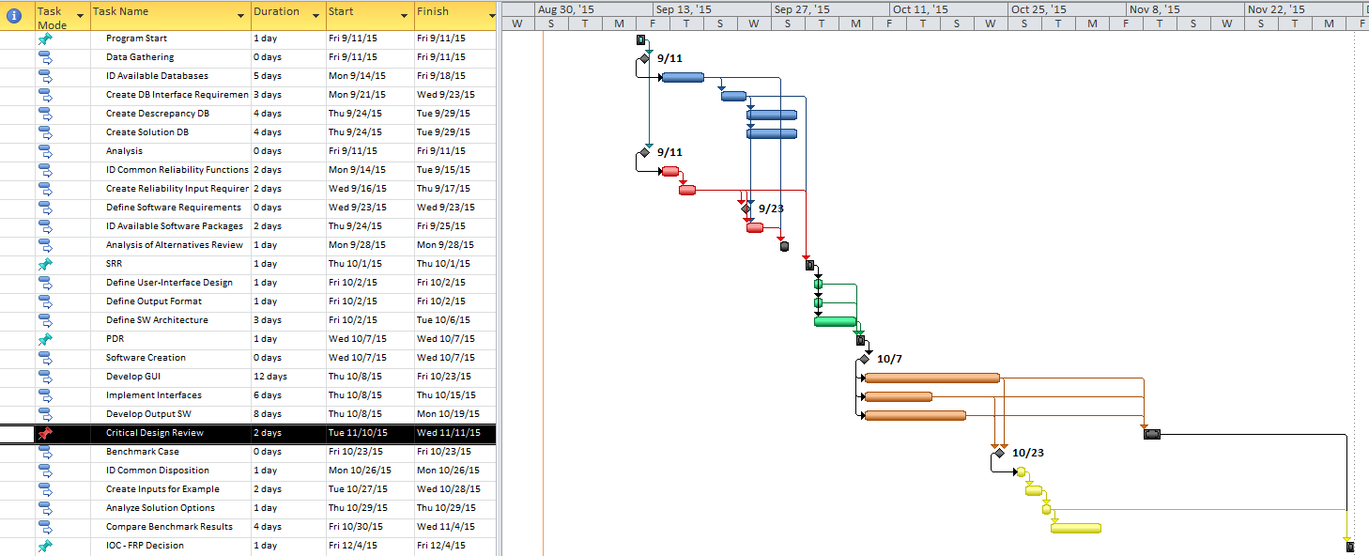
Master Schedule

